Slide 1
Implementation of EDF scheduler in FreeRTOS
Team 1

Slide 2
Overview
Team 1
Changes In code that is not in the Thesis
Task set and its parameters
Verifying System (Analytical methods, Simulator, Runtime analysis)
Bonus

Slide 3
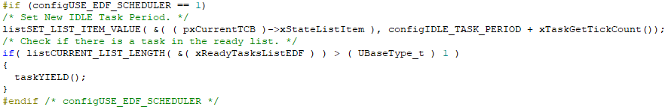
Changes in Code - Increase Idle Task Deadline
Team 1

Slide 4
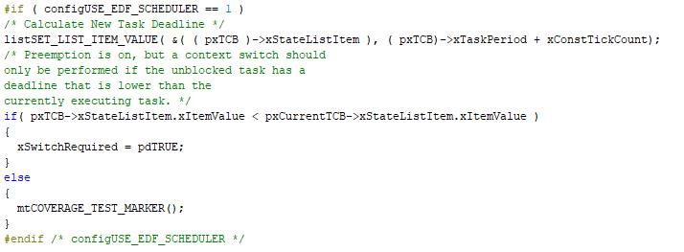
Changes in Code - xTaskIncrementTick
Team 1

Slide 5

Task Set
Team 1
This is the suggested task set, to show the difference between the FP and EDF schedulers.
Task 1 {P: 5, PRI: 2, E: 3, D: 5}
Task 2 {P: 8, PRI: 1, E: 3, D: 8}

Slide 6
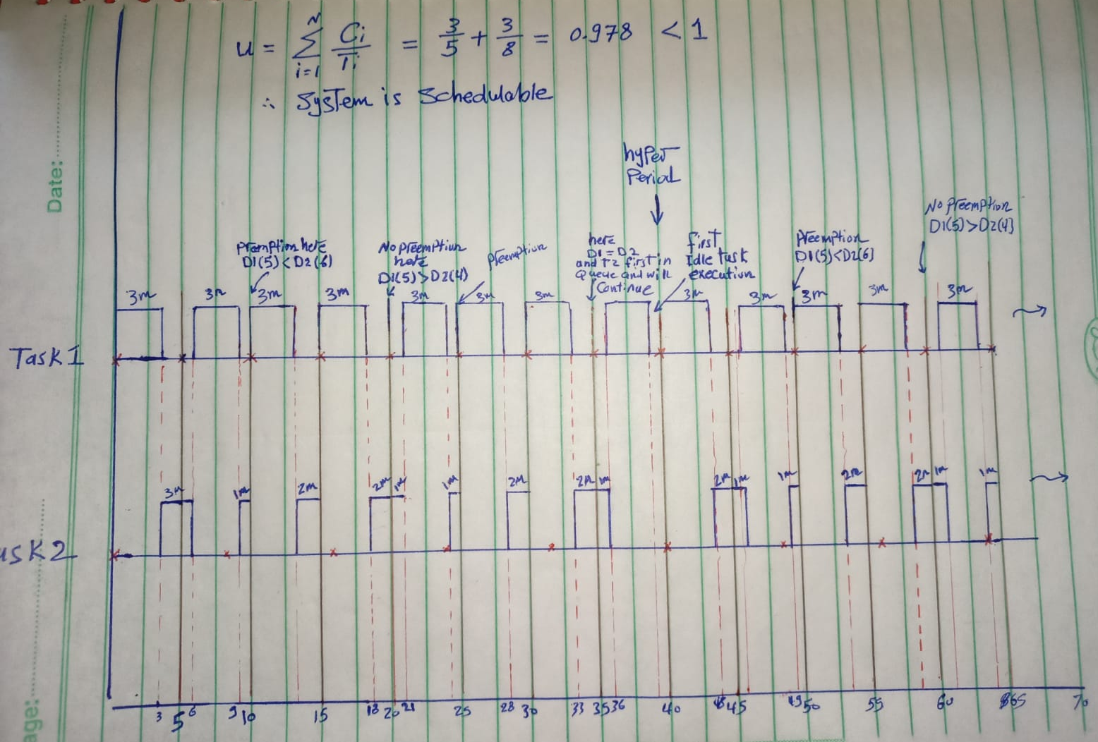
Verifying System - Analytical Methods
Team 1
Using Analytical methods:
proved that the suggested task set is schedulable.
validated the schedulability by drawing the system through its hyperperiod.

Slide 7
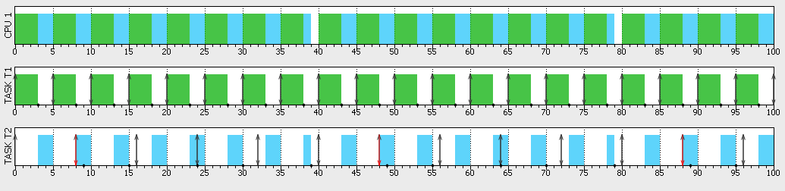
Verifying System - Simulation FP
Team 1
Task 2 Misses its deadline on using a FP scheduler.

Slide 8
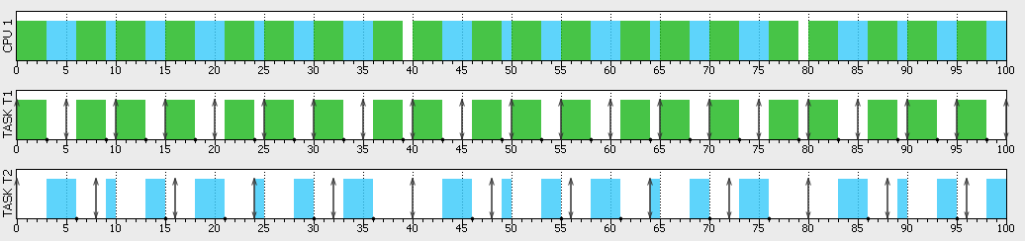
Verifying System - Simulation EDF
Team 1
Task 2 doesn’t miss its deadline on using an EDF scheduler.
The graph is similar to the graph drawn by hand.

Slide 9

Verifying System - Simulation CPU Load
Team 1
CPU Load was the same for the two scheduler
The system is overloaded, but this is only to demonstrate the difference in missing deadline between the two schedulers

Slide 10
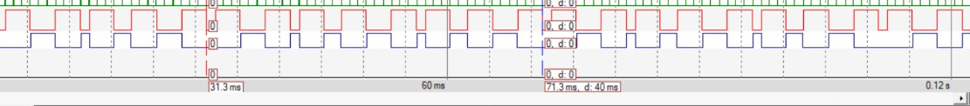
Verifying System - Runtime Analysis
Team 1
The task graph is similar to the analytical method and simulator.
The hyperperiod is the same to the analytical method and simulator (40ms).

Slide 11

Verifying System - Runtime Analysis
Team 1
Verified that the CPU Load is the same as in the simulation.

Slide 12

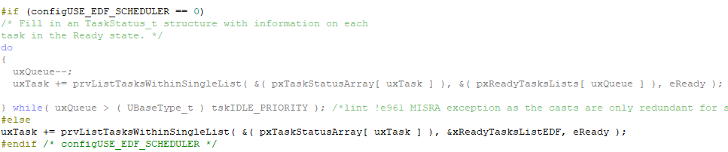
Bonus
Team 1
This is the suggested change in uxTaskGetSystemState Api to enable runtime stats of the FreeRTOS with the EDF scheduler.

